Slide 1

DDL,DML Commands
Create & Modify database
--- By ---
1. Tanmay Ashok Khedekar
2. Shantanu Hanuman Jivtode
3. Ritesh Raghunath Dhumal

Slide 2

Introduction
What is SQL ?
SQL stands for Structured Query Language
SQL lets you access and manipulate database
SQL is case insensitive. But it is a recommended practice to use keywords (like SELECT, UPDATE, CREATE, etc.) in capital letters and use user-defined things (like table name, column name, etc.) in small letters.

Slide 3

Importance of SQL
A Programming Language Not Only Limited To Programming Tasks
Helpful in Handling Huge Amounts of Structured Data
A Useful Tool for Data Analytics
Data Management and Manipulation
Standardized Language
Interdisciplinary Utility
Scalability and Flexibility

Slide 4

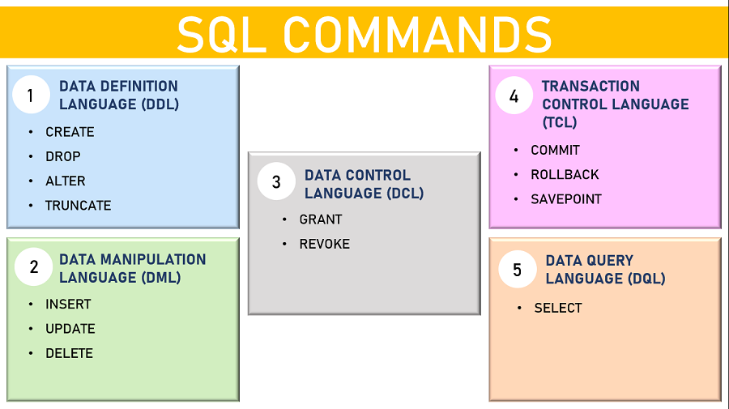

Slide 5
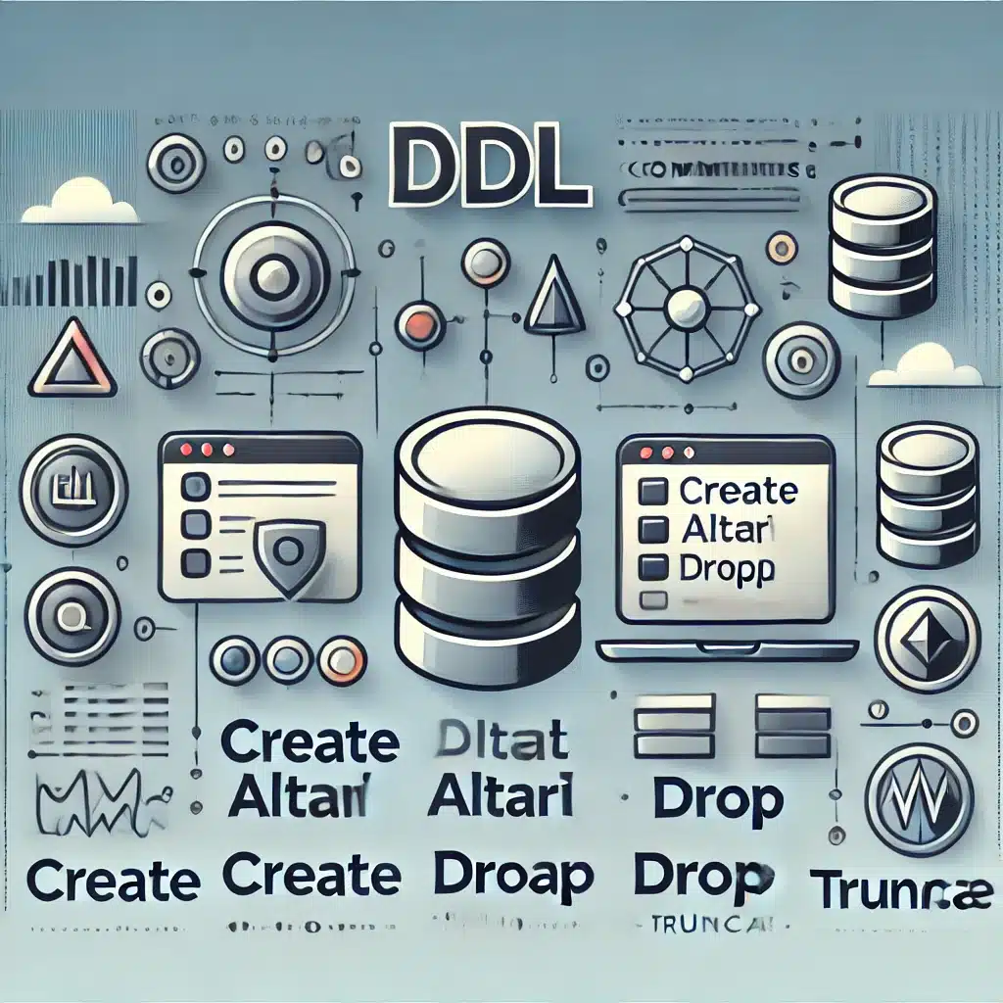
1.DDL COMMANDS
DDL or Data Definition Language actually consists of the SQL commands that can be used to defining, altering, and deleting database structures such as tables, indexes, and schemas. It simply deals with descriptions of the database schema and is used to create and modify the structure of database objects in the database
Example : Common examples of DDL statements include CREATE, ALTER, and DROP

Slide 6

2.DML COMMANDS
DML (Data Manipulation Language) is a type of SQL command used to manipulate data in a database. It inserts, updates ,and deletes data from a database table.
Examples of DML statements include INSERT, UPDATE, and DELETE.

Slide 7




BEST PRACTICES FOR SQL
Avoiding common pitfalls
Maintain data accuracy
Including writing efficient and readable code
Backing up databases

Slide 8

Conclusion
SQL, or Structured Query Language, is a powerful tool for managing and manipulating data stored in relational databases. From its fundamental principles to its diverse real-world applications, SQL plays a pivotal role in various industries and domains.

